Slide 1
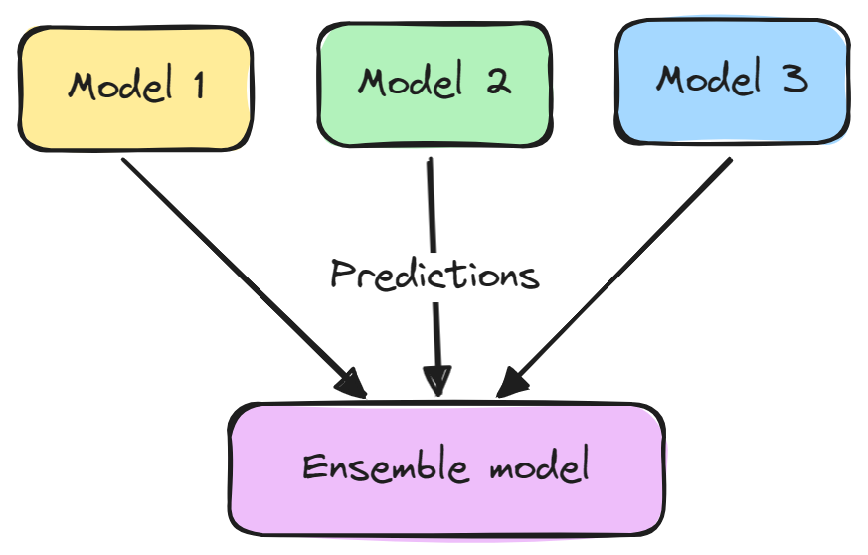
Ensemble learning
Ensemble learning is a machine learning approach that combines multiple individual models to improve the overall performance, accuracy, and robustness of the predictions.
The core idea is that combining several weak models (models that perform slightly better than random guessing) or strong models (more accurate models) will produce a model that performs better than any individual model.
Ensemble learning is particularly useful in reducing overfitting, improving generalization, and handling noisy data.
https://www.datacamp.com/tutorial/what-bagging-in-machine-learning-a-guide-with-examples

Slide 2
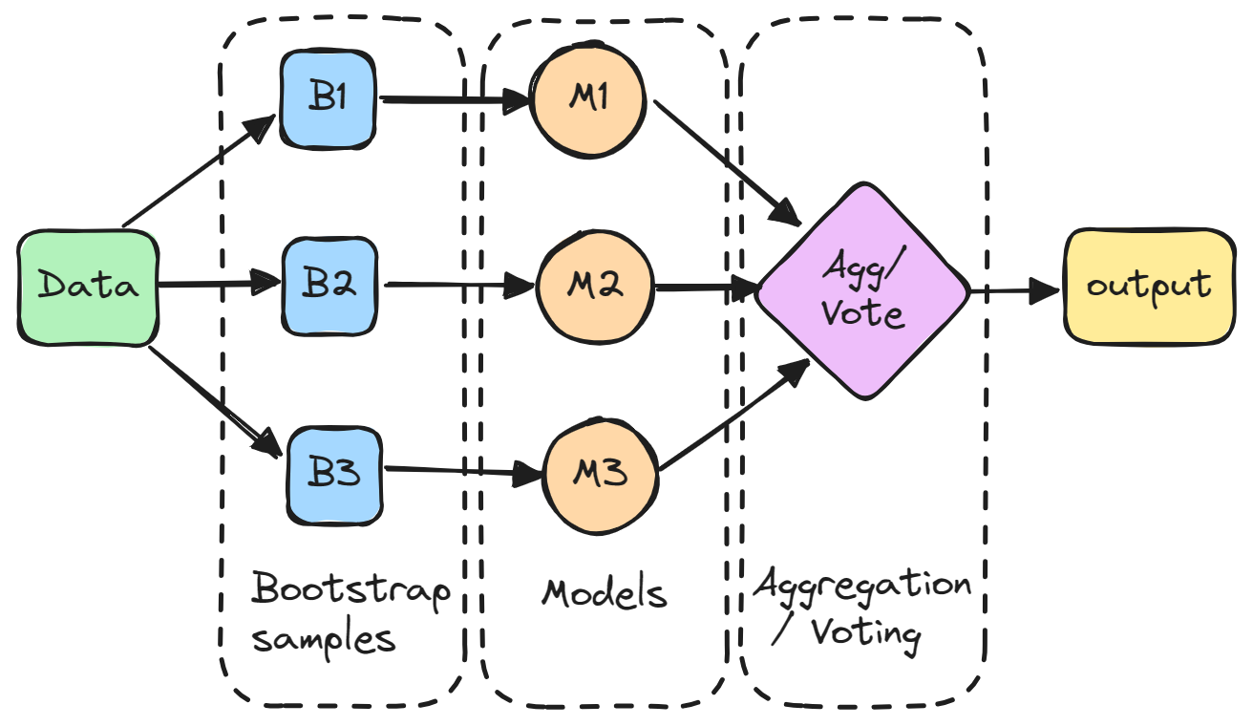
Types of Ensemble Learning Techniques
Bagging (Bootstrap Aggregating)
In bagging, multiple models are trained in parallel on different subsets of the training data (created by randomly sampling with replacement).
Each model’s predictions are combined (averaged or majority voting) to make the final prediction.
Example: Random Forest is a popular bagging algorithm that uses multiple decision trees.
https://www.datacamp.com/tutorial/what-bagging-in-machine-learning-a-guide-with-examples

Slide 3
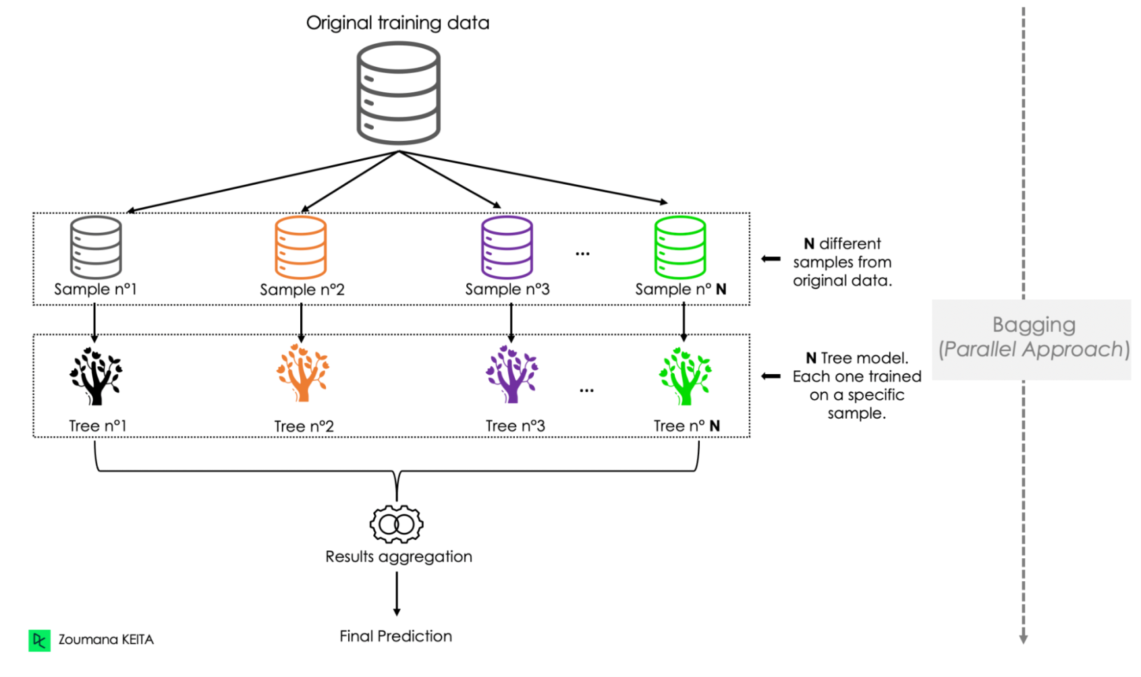
Types of Ensemble Learning Techniques
Bagging (Bootstrap Aggregating)
https://www.datacamp.com/tutorial/what-bagging-in-machine-learning-a-guide-with-examples

Slide 4
Types of Ensemble Learning Techniques
Boosting
Boosting sequentially builds models, with each new model focusing on correcting the errors of the previous one.
Each model is weighted based on its accuracy, and more focus is given to incorrectly classified data points.
Boosting improves model performance and reduces bias.
Examples: AdaBoost, Gradient Boosting, and XGBoost are commonly used boosting algorithms.
https://www.datacamp.com/tutorial/what-bagging-in-machine-learning-a-guide-with-examples

Slide 5
Types of Ensemble Learning Techniques
How Boosting Works
Boosting combines weak learners into a single strong model through a structured process focused on reducing errors in sequential training.
The steps are as follows:
1. Assign Initial Weights: Each data point is initially weighted to reflect its importance in learning
2. Sequential Training: Train the first weak learner on the data, then evaluate its performance. Increase the weights of misclassified instances to encourage the next learner to focus on these harder cases.
3. Repeat the Process: Continue adjusting weights and training additional learners, with each new model addressing the ensemble's current weaknesses.
4. Aggregate Results: Combine predictions from all weak learners, typically in a weighted manner, giving more accurate learners greater influence on the final output.
https://www.datacamp.com/tutorial/what-bagging-in-machine-learning-a-guide-with-examples

Slide 6
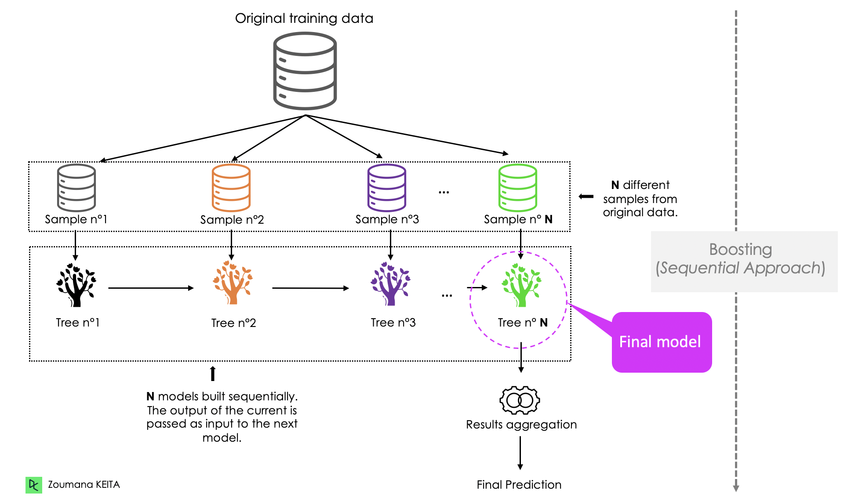
Types of Ensemble Learning Techniques
Boosting
https://www.datacamp.com/tutorial/what-bagging-in-machine-learning-a-guide-with-examples

Slide 7
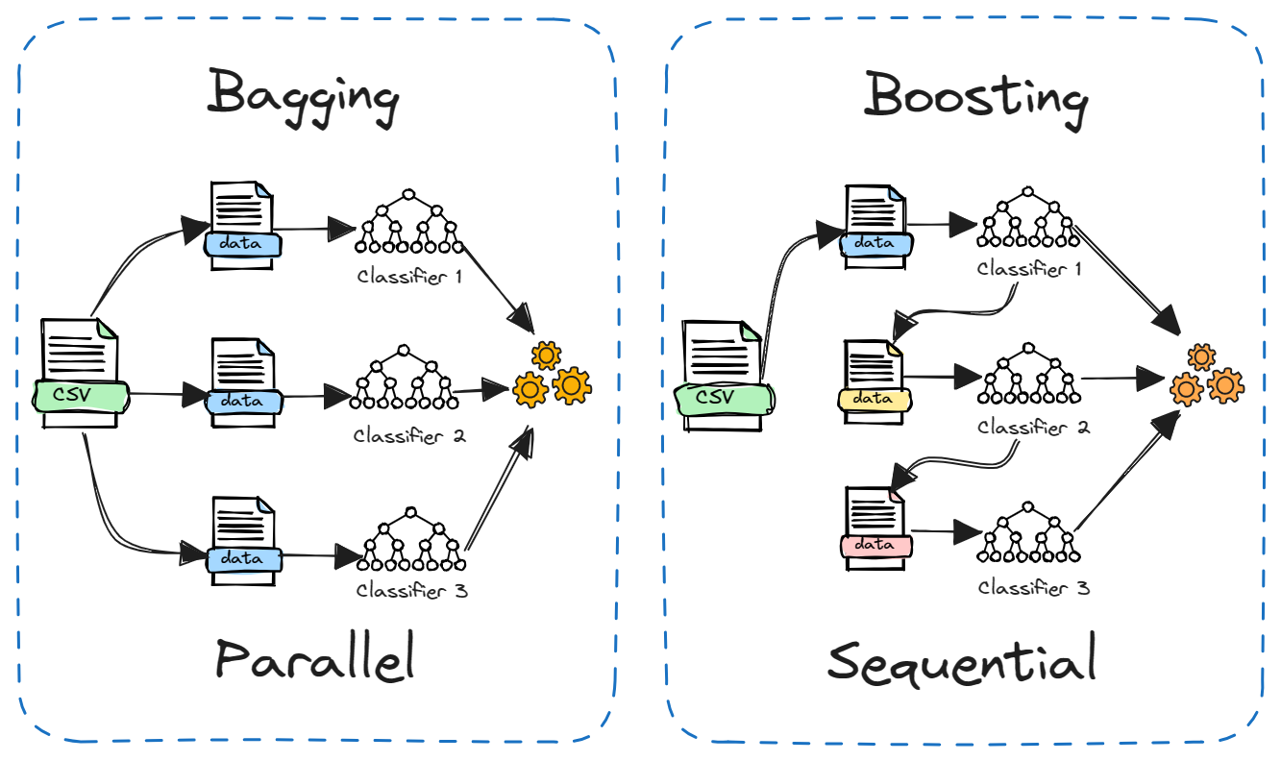
Types of Ensemble Learning Techniques
Bagging vs. Boosting
Bagging usually combines models through simple averaging, while boosting assigns weights to models based on their accuracy.
https://www.datacamp.com/tutorial/what-bagging-in-machine-learning-a-guide-with-examples

Slide 8
Types of Ensemble Learning Techniques
Stacking (Stacked Generalization)
In stacking, different models (of varying types) are trained on the same dataset, and a meta-model is then trained to combine their outputs.
This meta-model learns the best way to combine the predictions from the individual models.
Unlike bagging and boosting, stacking allows for using different algorithms, which helps capture diverse patterns in the data.
Example: Using a combination of decision trees, logistic regression, and SVMs as base models, with a linear regression as the meta-model.
https://www.datacamp.com/tutorial/what-bagging-in-machine-learning-a-guide-with-examples

Slide 9
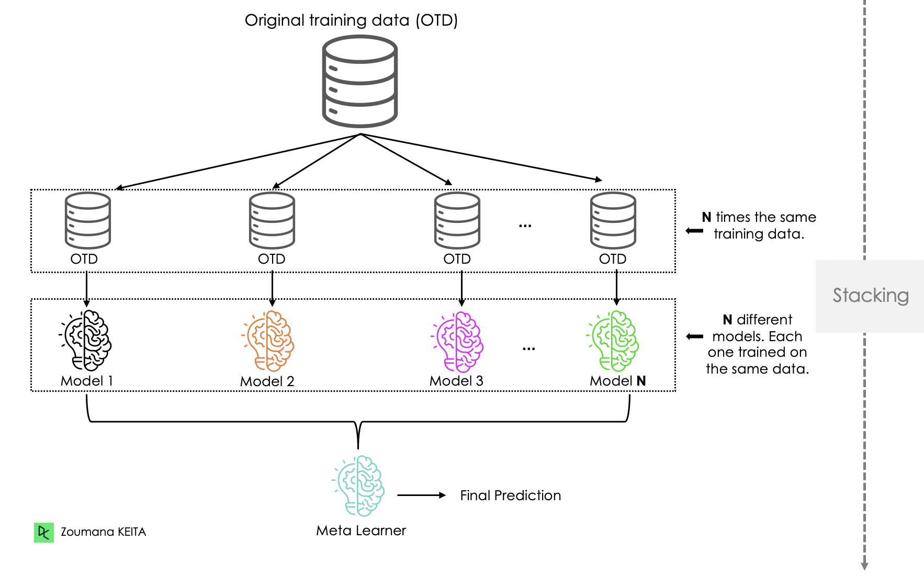
Types of Ensemble Learning Techniques
Stacking (Stacked Generalization)
https://www.datacamp.com/tutorial/what-bagging-in-machine-learning-a-guide-with-examples

Slide 10
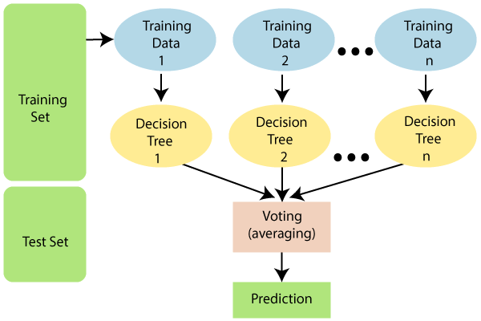
Random Forest
Random Forest is an ensemble learning algorithm primarily used for classification and regression tasks.
It combines multiple decision trees to create a more accurate, robust, and less overfitting-prone model.
The underlying concept is based on bagging (bootstrap aggregating), where each decision tree is trained on a different random subset of the training data, and the final prediction is made by averaging or taking a majority vote of the predictions from all trees.
https://www.javatpoint.com/machine-learning-random-forest-algorithm

Slide 11
Random Forest
Key Features of Random Forest
Random Subsampling of Data:
Each decision tree is trained on a randomly selected subset of the training data with replacement (bootstrapping).
This ensures each tree has slightly different data, leading to diverse trees that capture various patterns in the dataset.
Feature Randomness:
For each split within a tree, only a random subset of features is considered rather than the full feature set.
This feature randomness helps reduce the correlation between trees, improving overall model performance and preventing overfitting.

Slide 12
Random Forest
Key Features of Random Forest
Prediction Aggregation:
For classification, each tree votes for a class, and the class with the most votes becomes the final prediction.
For regression, predictions from all trees are averaged to get the final result.

Slide 13
Random Forest
Key Features of Random Forest
Prediction Aggregation:
For classification, each tree votes for a class, and the class with the most votes becomes the final prediction.
For regression, predictions from all trees are averaged to get the final result.
Colab Implementation: Click here

Slide 14
Performance Measure in Classification
aa

